Slide 1
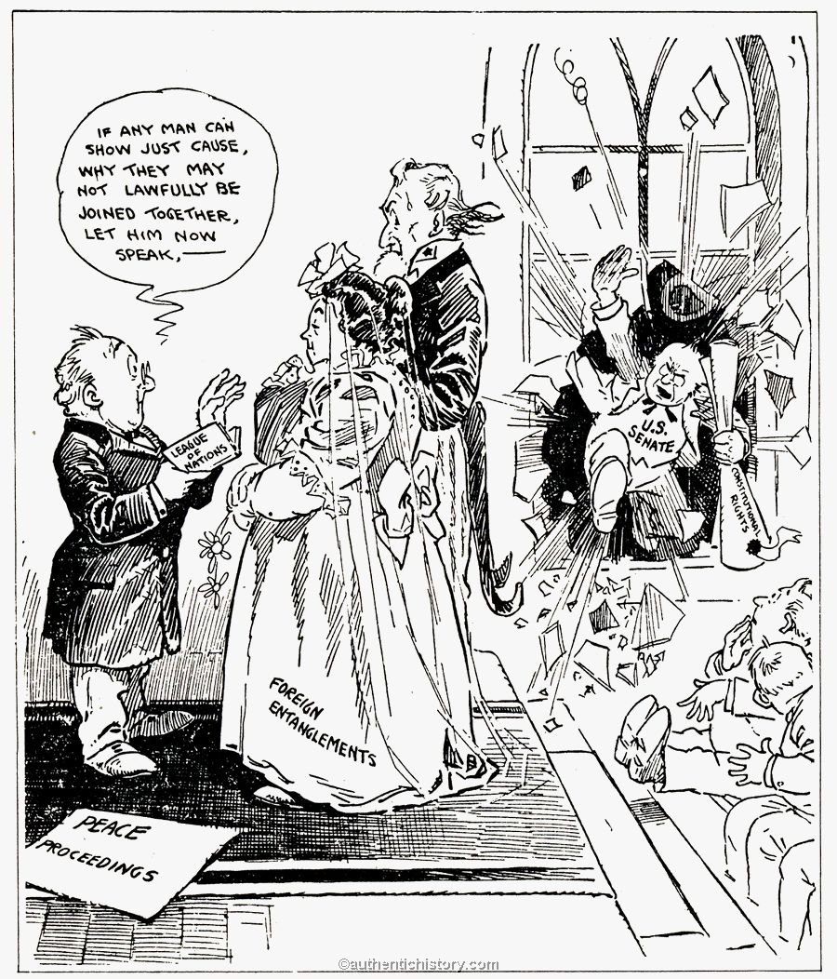
VI. U.S. Rejection of the Treaty of Versailles
Some thought the Treaty was too harsh.
Others thought it didn’t go far enough.
Henry Cabot Lodge led the Senate opposition.
The public favored the Treaty, with reservations.
After Wilson’s stroke, the Democrats lacked a leader.
Wilson ordered Democrats to reject the Treaty with Reservations.
The country was shocked by this exhibition of legislative paralysis.
Wilson looked at the Election of 1920 as a “solemn referendum” on the League.
Harding’s election showed that Americans were not ready to lead in 1920

Slide 2
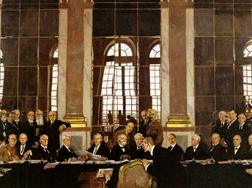
V. Wilson’s World Vision is Rejected
The European Powers did not share Wilson’s idealism.
Wilson became politically clumsy.
He only was able to get 4 of his 14 points into the Treaty.
He was able to push the League of Nations through.
Wilson staked the Treaty on the League.

