Slide 1
The Rise of American Imperialism

Slide 2
Type 1 Writing
What is the appropriate role in world affairs for the United States?

Slide 3
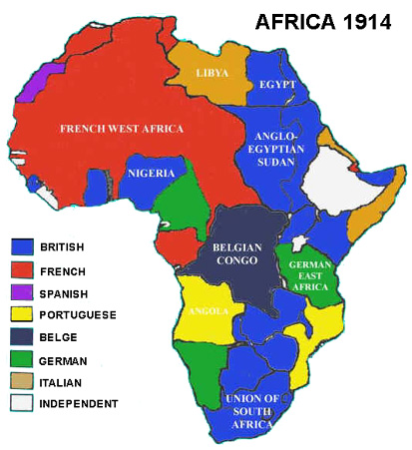
U.S. Inaction
1871 – European powers began an era of imperialistic expansion.
“Scramble for Africa”
The U.S. did not take part in this expansion until the 1890s.

Slide 4
Reasons for Foreign Policy Inaction
Expansion was focused Westward
The American frontier did not “close” until the last decade of the century.
Rapid industrial growth, urbanization and a large influx of immigrants had Americans focused inward.

Slide 5
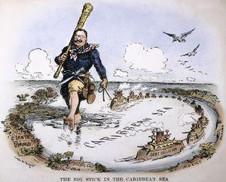
The1890s: Reasons for American Imperialism

Slide 6
Rapid Industrial Growth
Created a need for both sources of raw materials and markets for finished products.
Commercial expansion led to a demand for the buildup of American naval forces.
Naval bases were needed to protect American trade abroad.

Slide 7
Revitalized American Nationalism
What is nationalism?
How might it impact American foreign policy?
The American government wanted to be taken seriously.
Historic sense of Manifest Destiny.

Slide 8
Missionary Zeal
“White Man’s Burden” – commitment of Christian missionaries to bring religion to far off lands.

